Slide 1


Microprocessors and Assembly Language Spring 2020
Hamed Farbeh
farbeh@aut.ac.ir
Department of Computer Engineering
Amirkabir University of Technology
Lecture 7

Slide 2
Copyright Notice
Parts (text & figures) of this lecture are adopted from:
Design of Microprocessor-Based Systems (aka Embedded Systems Design and Implementation), Prabal Dutta, University of Michigan
Cortex™-M3 Revision r2p1 Technical Reference Manual
ARMv7-M Architecture Reference Manual
Atmel | SMART ARM-based MCU DATASHEET, SAM3X / SAM3A Series, Atmel-11057C-ATARM-SAM3X-SAM3A-Datasheet_23-Mar-15
Microprocessors and Assembly Language, Spring 2020, AUT, Tehran, Iran

Slide 3
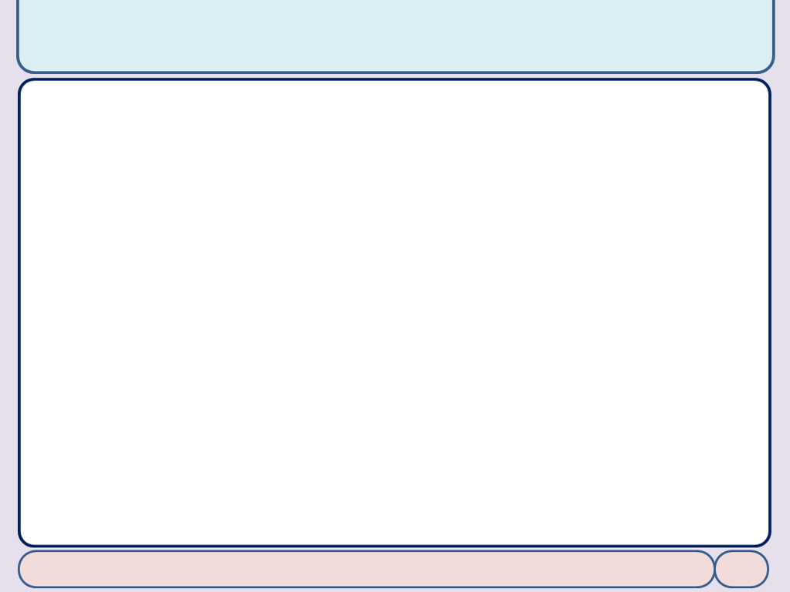
Serial Peripheral Interface (SPI)
Microprocessors and Assembly Language, Spring 2020, AUT, Tehran, Iran

Slide 4
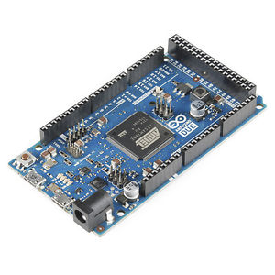
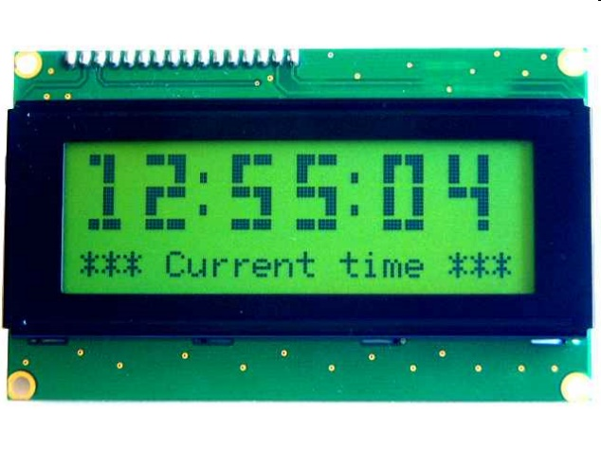
SPI Description
Synchronous serial data link
Provides communication with external devices in Master or Slave Mode
Is essentially a shift register that serially transmits data bits to other SPIs
Fast, Easy to use, Simple
A communication protocol using 4 wires
Also known as a 4 wire bus
Used to communicate across small distances
Chapter 32: Atmel | SMART ARM-based MCU DATASHEET, SAM3X / SAM3A Series, Atmel-11057C-ATARM-SAM3X-SAM3A-Datasheet_23-Mar-15
Microprocessors and Assembly Language, Spring 2020, AUT, Tehran, Iran

Slide 5
SPI Capabilities
Always Full Duplex
Communicating in two directions at the same time
Multiple Mbps transmission speed
Transfers data in 8 to 16 bit characters
Multiple slaves
Daisy-chaining possible
Master controls the data flow
Other devices act as slaves which have data shifted into and out by the master
Chapter 32: Atmel | SMART ARM-based MCU DATASHEET, SAM3X / SAM3A Series, Atmel-11057C-ATARM-SAM3X-SAM3A-Datasheet_23-Mar-15
Microprocessors and Assembly Language, Spring 2020, AUT, Tehran, Iran

Slide 6
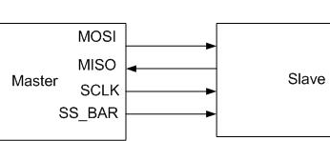
SPI Protocol
Wires
Two data lines and two control lines
Master Out Slave In (MOSI)
Supplies the output data from the master shifted into the input(s) of the slave(s)
Master In Slave Out (MISO)
Supplies the output data from a slave to the input of the master
Serial Clock (SPCK)
Is driven by the master and regulates the flow of the data bits. The master may transmit data at a variety of baud rates; the SPCK line cycles once for each bit that is transmitted
Slave Select (NSS)
Allows slaves to be turned on and off by hardware
Chapter 32: Atmel | SMART ARM-based MCU DATASHEET, SAM3X / SAM3A Series, Atmel-11057C-ATARM-SAM3X-SAM3A-Datasheet_23-Mar-15
Microprocessors and Assembly Language, Spring 2020, AUT, Tehran, Iran

Slide 7
Embedded Characteristics
Supports Communication with Serial External Devices
Four Chip Selects with External Decoder Support Allow Communication with Up to 15 Peripherals
Serial Memories, such as DataFlash and 3-wire EEPROMs
Serial Peripherals, such as ADCs, DACs, LCD Controllers, CAN Controllers and Sensors
External Co-processors
Chapter 32: Atmel | SMART ARM-based MCU DATASHEET, SAM3X / SAM3A Series, Atmel-11057C-ATARM-SAM3X-SAM3A-Datasheet_23-Mar-15
Microprocessors and Assembly Language, Spring 2020, AUT, Tehran, Iran

Slide 8
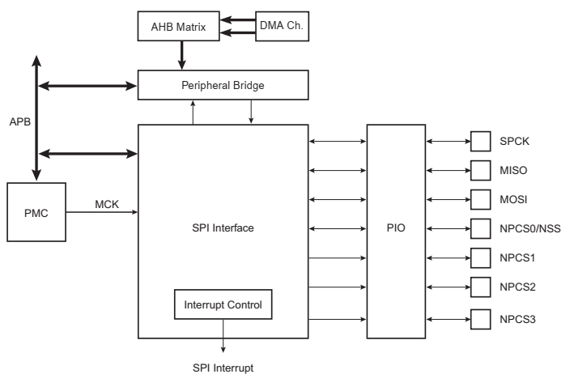
Block Diagram
Chapter 32: Atmel | SMART ARM-based MCU DATASHEET, SAM3X / SAM3A Series, Atmel-11057C-ATARM-SAM3X-SAM3A-Datasheet_23-Mar-15
Microprocessors and Assembly Language, Spring 2020, AUT, Tehran, Iran

Slide 9
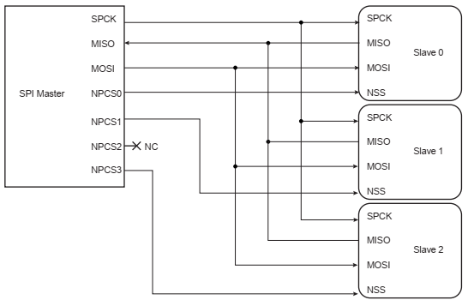
Block Diagram
Chapter 32: Atmel | SMART ARM-based MCU DATASHEET, SAM3X / SAM3A Series, Atmel-11057C-ATARM-SAM3X-SAM3A-Datasheet_23-Mar-15
Microprocessors and Assembly Language, Spring 2020, AUT, Tehran, Iran

Slide 10
Product Dependencies
NOTE
The pins used for interfacing the compliant external devices may be multiplexed with PIO lines. The programmer must first program the PIO controllers to assign the SPI pins to their peripheral functions
Chapter 32: Atmel | SMART ARM-based MCU DATASHEET, SAM3X / SAM3A Series, Atmel-11057C-ATARM-SAM3X-SAM3A-Datasheet_23-Mar-15
Microprocessors and Assembly Language, Spring 2020, AUT, Tehran, Iran

Slide 11
Functional Description
Modes of Operation: Master and Slave
Master Mode: MSTR bit = 1 in the Mode Register (SPI_MR)
The pins NPCS0 to NPCS3 are all configured as outputs
SPCK pin is driven
The MISO line is wired on the receiver input
The MOSI line driven as an output by the transmitter
Slave Mode: MSTR bit = 0 in the Mode Register (SPI_MR)
The MISO line is driven by the transmitter output
The MOSI line is wired on the receiver input
The SPCK pin is driven by the transmitter to synchronize the receiver
The NPCS0 pin becomes an input, and is used as a Slave Select signal (NSS)
The pins NPCS1 to NPCS3 are not driven and can be used for other purposes
Chapter 32: Atmel | SMART ARM-based MCU DATASHEET, SAM3X / SAM3A Series, Atmel-11057C-ATARM-SAM3X-SAM3A-Datasheet_23-Mar-15
Microprocessors and Assembly Language, Spring 2020, AUT, Tehran, Iran

Slide 12
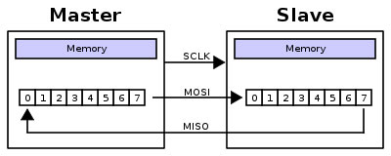
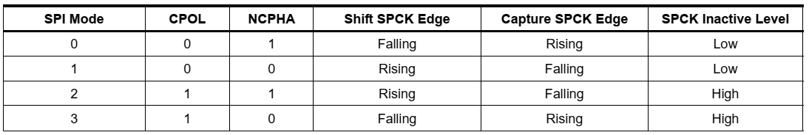
Data Transfer
Two phases and two polarities of clock
program clock polarity: CPOL bit in the Chip Select Register
program clock phase: NCPHA bit
These two parameters determine the edges of the clock signal on which data is driven and sampled
Chapter 32: Atmel | SMART ARM-based MCU DATASHEET, SAM3X / SAM3A Series, Atmel-11057C-ATARM-SAM3X-SAM3A-Datasheet_23-Mar-15
Microprocessors and Assembly Language, Spring 2020, AUT, Tehran, Iran

Slide 13
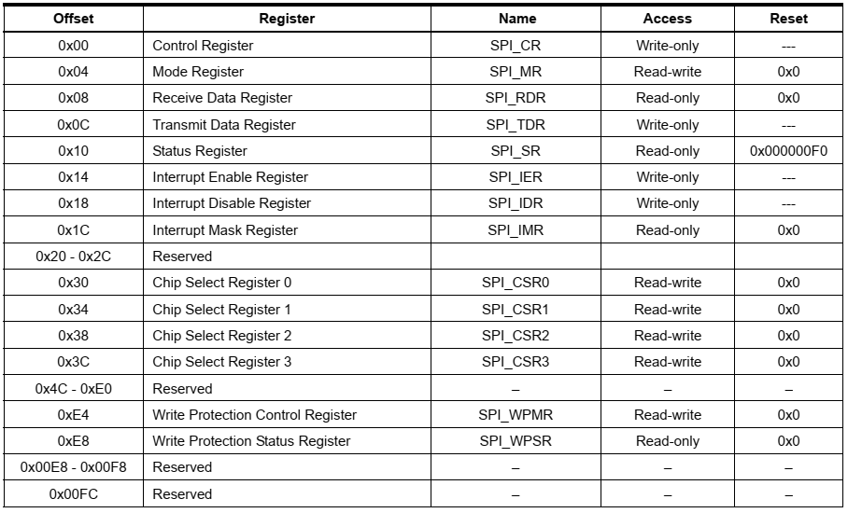
SPI User Interface
Chapter 32: Atmel | SMART ARM-based MCU DATASHEET, SAM3X / SAM3A Series, Atmel-11057C-ATARM-SAM3X-SAM3A-Datasheet_23-Mar-15
Microprocessors and Assembly Language, Spring 2020, AUT, Tehran, Iran

Slide 14
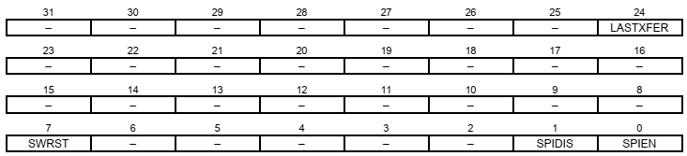
SPI Control Register
Write-only Register
SPIEN: SPI Enable
SPIDIS: SPI Disable
If both SPIEN and SPIDIS are equal to one when the control register is written, the SPI is disabled
SWRST: SPI Software Reset
Reset the SPI. A software-triggered hardware reset of the SPI interface is performed
The SPI is in slave mode after software reset
Chapter 32: Atmel | SMART ARM-based MCU DATASHEET, SAM3X / SAM3A Series, Atmel-11057C-ATARM-SAM3X-SAM3A-Datasheet_23-Mar-15
Microprocessors and Assembly Language, Spring 2020, AUT, Tehran, Iran

Slide 15
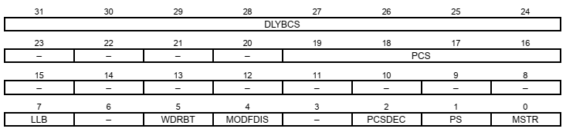
SPI Mode Register
Read-Write Register
MSTR: Master/Slave Mode
PS: Peripheral Select
0 = Fixed Peripheral Select.
1 = Variable Peripheral Select
PCSDEC: Chip Select Decode
0 = The chip selects are directly connected to a peripheral device
1 = The four chip select lines are connected to a 4- to 16-bit decoder
Chapter 32: Atmel | SMART ARM-based MCU DATASHEET, SAM3X / SAM3A Series, Atmel-11057C-ATARM-SAM3X-SAM3A-Datasheet_23-Mar-15
Microprocessors and Assembly Language, Spring 2020, AUT, Tehran, Iran

Slide 16
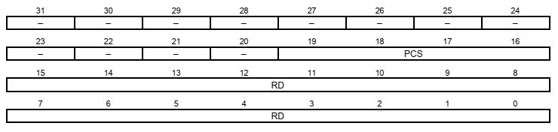
SPI Receive Data Register
Read-Only Register
RD: Receive Data
Data received by the SPI Interface is stored in this register right-justified
PCS: Peripheral Chip Select
In Master Mode only, these bits indicate the value on the NPCS pins at the end of a transfer
Chapter 32: Atmel | SMART ARM-based MCU DATASHEET, SAM3X / SAM3A Series, Atmel-11057C-ATARM-SAM3X-SAM3A-Datasheet_23-Mar-15
Microprocessors and Assembly Language, Spring 2020, AUT, Tehran, Iran

Slide 17
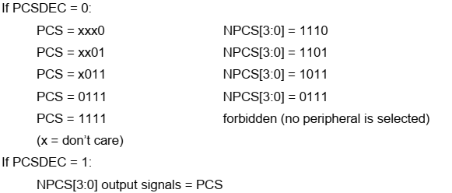
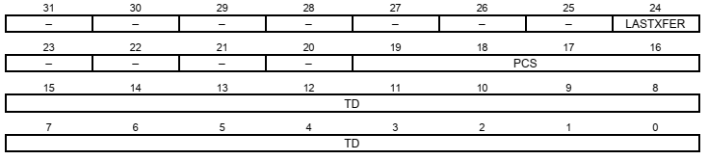
SPI Transmit Data Register
Write-Only Register
TD: Transmit Data
Data to be transmitted by the SPI Interface is stored in this register
PCS: Peripheral Chip Select
This field is only used if Variable Peripheral Select is active
Chapter 32: Atmel | SMART ARM-based MCU DATASHEET, SAM3X / SAM3A Series, Atmel-11057C-ATARM-SAM3X-SAM3A-Datasheet_23-Mar-15
Microprocessors and Assembly Language, Spring 2020, AUT, Tehran, Iran

Slide 18
The End (for now)!
Microprocessors and Assembly Language, Spring 2020, AUT, Tehran, Iran

